Slide 2
John 3:16 - King James Version
¹⁶ For God so loved the world, that he gave his only begotten Son, that whosoever believeth in him should not perish, but have everlasting life.

Slide 3
Jesus is the Reason
For the Season

Slide 4
2nd Sunday of Advent: Peace
2023: A Year of Service – Be A Disciple
Today’s Scripture:
| Luke 1 - Selected Verses |
~ Amplified Bible ~

Slide 5
Birth of John the Baptist Foretold
⁵ In the days of Herod [the Great], king of Judea, there was a certain priest whose name was Zacharias, of the division of Abijah. His wife was a descendant of Aaron [the first high priest of Israel], and her name was Elizabeth.

Slide 6
⁶ They both were righteous (approved) in the sight of God, walking blamelessly in all the commandments and requirements of the Lord. ⁷ But they were childless, because Elizabeth was barren, and they were both far advanced in years.

Slide 7
⁸ Now it happened while Zacharias was serving as priest before God in the appointed order of his priestly division, ⁹ as was the custom of the priesthood, he was chosen by lot to enter [the sanctuary of] the temple of the Lord and burn incense [on the altar of incense].
¹⁰ And all the congregation was praying outside [in the court of the temple] at the hour of the incense offering.

Slide 8
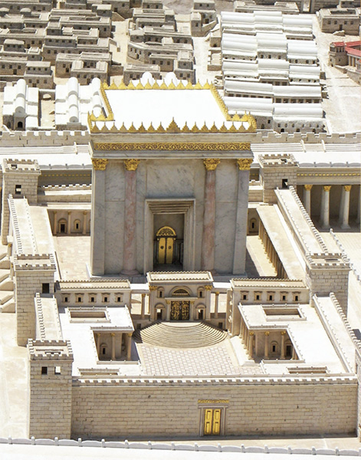

Slide 9
¹¹ And an angel of the Lord appeared to him, standing to the right of the altar of incense. ¹² When Zacharias saw the angel, he was troubled and overcome with fear. ¹³ But the angel said to him, “Do not be afraid, Zacharias (the Lord has remembered), because your petition [in prayer] was heard, and your wife Elizabeth (pledged to God) will bear you a son, and you will name him John. (Jehovah is gracious.)

Slide 10
¹⁴ You will have great joy and delight, and many will rejoice over his birth, ¹⁵ for he will be great and
distinguished in the sight of the Lord; and will never drink wine or liquor, and he will be filled with and
empowered to act by the Holy Spirit while still in his mother’s womb.

Slide 11
¹⁶ He will turn many of the sons of Israel back [from sin] to [love and serve] the Lord their God. ¹⁷ It is he who will go as a forerunner before Him in the spirit and power of Elijah, to turn the hearts of the fathers back to the children, and the disobedient to the attitude of the righteous [which is to seek and submit to the will of God]—in order to make ready a people [perfectly] prepared [spiritually and morally] for the Lord.”

Slide 12
¹⁸ And Zacharias said to the angel, “How will I be certain of this? For I am an old man and my wife is advanced in age.” ¹⁹ The angel replied and said to him, “I am Gabriel; I stand and minister in the [very] presence of God, and I have been sent [by Him] to speak to you and to bring you this good news.

Slide 13
²⁰ Listen carefully, you will be continually silent and unable to speak until the day when these things take place, because you did not believe what I told you; but my words will be fulfilled at their proper time.”

Slide 14
²¹ The people [outside in the court] were waiting for Zacharias, and were wondering about his long delay in the temple. ²² But when he did come out, he was unable to speak to them. They realized that he had seen a vision in the temple; and he kept making signs to them, and remained mute. ²³ When his time of priestly service was finished, he returned to his home.

Slide 15
²⁴ Now after this his wife Elizabeth became pregnant, and for five months she secluded herself completely, saying, ²⁵ “This is how the Lord has dealt with me in the days when He looked with favor on me, to take away my disgrace among men.”

