Slide 2
John 3:16 - King James Version
¹⁶ For God so loved the world, that he gave his only begotten Son, that whosoever believeth in him should not perish, but have everlasting life.

Slide 3
Jesus IS the Reason
For the Season

Slide 4
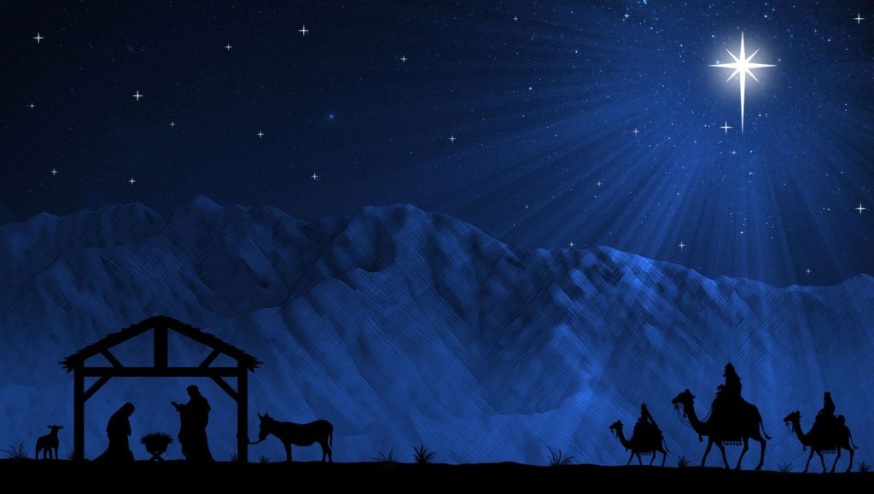
First Sunday of Advent – Hope
Second Sunday of Advent – Peace
Third Sunday of Advent - Joy

Slide 5
4th Sunday of Advent: Love
2023: A Year of Service – Be A Disciple
Today’s Scripture:
| Luke 1:26-38; 2:1-12 |
~ Amplified Bible ~

Slide 6
¹³ Then Isaiah said, “Hear then, O house of David! Is it too small a thing for you to try the patience of men, but will you try the patience of my God as well?
¹⁴ Therefore the Lord Himself will give you a sign: Listen carefully, the virgin will conceive and give birth to a son, and she will call his name Immanuel (God with us).
- Isaiah 7:13-14

Slide 7
Jesus’ Birth Foretold
²⁶ Now in the sixth month [of Elizabeth’s pregnancy] the angel Gabriel was sent from God to a city in Galilee called Nazareth, ²⁷ to a virgin betrothed to a man whose name was Joseph, a descendant of the house of David; and the virgin’s name was Mary.

Slide 8
²⁸ And coming to her, the angel said, “Greetings, favored one! The Lord is with you.” ²⁹ But she was greatly perplexed at what he said, and kept carefully considering what kind of greeting this was.

Slide 9
³⁰ The angel said to her, “Do not be afraid, Mary, for you have found favor with God. ³¹ Listen carefully: you will conceive in your womb and give birth to a son, and you shall name Him Jesus. ³² He will be great and
eminent and will be called the Son of the Most High; and the Lord God will give Him the throne of His father David;

Slide 10
³³ and He will reign over the house of Jacob (Israel) forever, and of His kingdom there shall be no end.”
³⁴ Mary said to the angel, “How will this be, since I am a virgin and have no intimacy with any man?”

Slide 11
³⁵ Then the angel replied to her, “The Holy Spirit will come upon you, and the power of the Most High will overshadow you [like a cloud]; for that reason the holy (pure, sinless) Child shall be called the Son of God.
³⁶ And listen, even your relative Elizabeth has also conceived a son in her old age; and she who was called barren is now in her sixth month.

Slide 12
³⁷ For with God nothing
[is or ever] shall be impossible.”

Slide 13
³⁸ Then Mary said, “Behold, I am the servant of the Lord; may it be done to me according to your word.” And the angel left her.

Slide 14
2 And it came to pass in those days, that there went out a decree from Caesar Augustus that all the world should be taxed. ² (And this taxing was first made when Cyrenius was governor of Syria.) ³ And all went to be taxed, every one into his own city.

Slide 15
⁴ And Joseph also went up from Galilee, out of the city of Nazareth, into Judaea, unto the city of David, which is called Bethlehem; (because he was of the house and lineage of David:) ⁵ To be taxed with Mary his espoused wife, being great with child. ⁶ And so it was, that, while they were there, the days were accomplished that she should be delivered.

Slide 16
⁷ And she brought forth her firstborn son, and wrapped him in swaddling clothes, and laid him in a manger; because there was no room for them in the inn.
⁸ And there were in the same country shepherds abiding in the field, keeping watch over their flock by night.
⁹ And, lo, the angel of the Lord came upon them, and the glory of the Lord shone round about them: and they were sore afraid.

Slide 17
¹⁰ And the angel said unto them, Fear not: for, behold, I bring you good tidings of great joy, which shall be to all people. ¹¹ For unto you is born this day in the city of David a Saviour, which is Christ the Lord. ¹² And this
shall be a sign unto you; Ye shall find the babe wrapped in swaddling clothes, lying in a manger.

