Slide 1
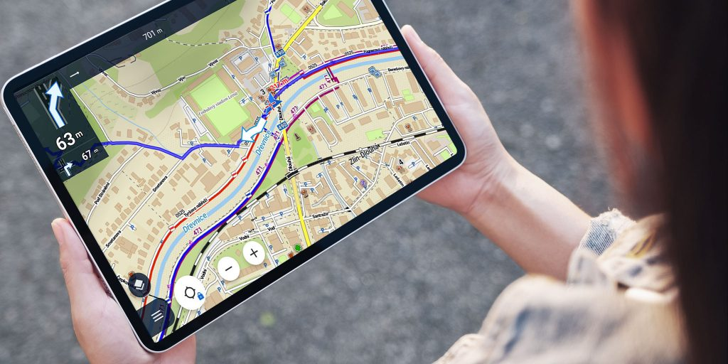

Slide 2
2024: Living a Life of Grace
Happy New Year!
Today’s Scripture:
| Selected Verses |
~ Amplified Bible ~

Slide 3
Ephesians 2:8-10
⁸ For it is by grace [God’s remarkable compassion and favor drawing you to Christ] that you have been saved [actually delivered from judgment and given eternal life] through faith. And this [salvation] is not of yourselves [not through your own effort], but it is the [undeserved, gracious] gift of God.

Slide 4
⁹ not as a result of [your] works, [nor your attempts to keep the Law], so that no one will [be able to] boast or take credit in any way [for his salvation].

Slide 5
¹⁰ For we are His workmanship [His own master work, a work of art], created in Christ Jesus [reborn from above—spiritually transformed, renewed, ready to be used] for good works, which God prepared [for us] beforehand [taking paths which He set], so that we would walk in them [living the good life which He prearranged and made ready for us].

Slide 6
James 4:6-7
⁶ But He gives us more and more grace [through the power of the Holy Spirit to defy sin and live an obedient life that reflects both our faith and our gratitude for our salvation]. Therefore, it says, “God is opposed to the proud and haughty, but [continually]
gives [the gift of] grace to the humble [who turn away from self-righteousness].”

Slide 7
⁷ So submit to [the authority of] God. Resist the devil [stand firm against him] and he will flee from you.

Slide 8
Romans 5:1-2
5 Therefore, since we have been justified [that is, acquitted of sin, declared blameless before God] by faith, [let us grasp the fact that] we have peace with God [and the joy of reconciliation with Him] through our Lord Jesus Christ (the Messiah, the Anointed).

Slide 9
² Through Him we also have access by faith into this [remarkable state of] grace in which we [firmly and safely and securely] stand. Let us rejoice in our hope
and the confident assurance of [experiencing and enjoying] the glory of [our great] God [the manifestation of His excellence and power].

Slide 10
Romans 3:23-24
²³ since all have sinned and continually fall short of the glory of God, ²⁴ and are being justified [declared free of the guilt of sin, made acceptable to God, and granted eternal life] as a gift by His [precious, undeserved]
grace, through the redemption [the payment for our sin] which is [provided] in Christ Jesus,

