Slide 1
Joshua, Good Advice
2024: Living a Life of Grace
Today’s Scripture:
| Joshua 1:1-9; 5:13-15; 24:14-15 |
~ Amplified Bible ~

Slide 2
God’s Commission to Joshua
1 Now it happened after the death of Moses the servant of the Lord, that the Lord spoke to Joshua the son of Nun, Moses’ servant (attendant), saying, ² “Moses My servant is dead; now therefore arise [to take his place], cross over this Jordan, you and all this people, into the land which I am giving to them, to the sons of Israel. ³ I have given you every place on which the sole of your foot treads, just as I promised to Moses.

Slide 3
⁴ From the wilderness [of Arabia in the south] and this Lebanon [in the north], even as far as the great river, the river Euphrates [in the east], all the land of the Hittites (Canaan), and as far as the Great [Mediterranean] Sea toward the west shall be your territory. ⁵ No man will [be able to] stand before you [to oppose you] as long as you live. Just as I was [present] with Moses, so will I be with you; I will not fail you or abandon you.

Slide 4
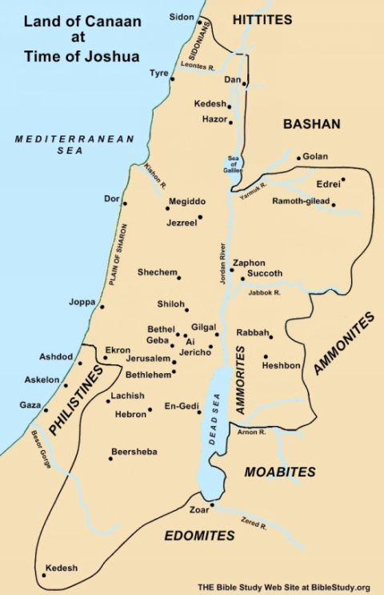

Slide 5
⁶ Be strong and confident and courageous, for you will give this people as an inheritance the land which I swore to their fathers (ancestors) to give them. ⁷ Only be strong and very courageous; be careful to do [everything] in accordance with the entire law which Moses My servant commanded you; do not turn from it to the right or to the left, so that you may prosper and be successful wherever you go.

Slide 6
⁸ This Book of the Law shall not depart from your mouth, but you shall read [and meditate on] it day and night, so that you may be careful to do [everything] in accordance with all that is written in it; for then you will make your way prosperous, and then you will be successful. ⁹ Have I not commanded you? Be strong and courageous! Do not be terrified or dismayed (intimidated), for the Lord your God is with you wherever you go.”

Slide 7
¹³ Now when Joshua was by Jericho, he looked up, and behold, a man was standing opposite him with his drawn sword in his hand, and Joshua went to him and said to him, “Are you for us or for our adversaries?”
¹⁴ He said, “No; rather I have come now as captain of the army of the Lord.” Then Joshua fell with his face toward the earth and bowed down, and said to him, “What does my lord have to say to his servant?” ¹⁵ The captain of the Lord’s army said to Joshua, “Remove your sandals from your feet, because the place where you are standing is holy (set apart to the Lord).” And Joshua did so.

Slide 8
¹⁴ “Now, therefore, fear the Lord and serve Him in sincerity and in truth; remove the gods which your fathers served on the other side of the [Euphrates] River and in Egypt, and serve the Lord. ¹⁵ If it is unacceptable in your sight to serve the Lord, choose for yourselves this day whom you will serve: whether the gods which your fathers served that were on the other side of the River, or the gods of the Amorites in whose land you live; but as for me and my house, we will serve the Lord.”

