Slide 1
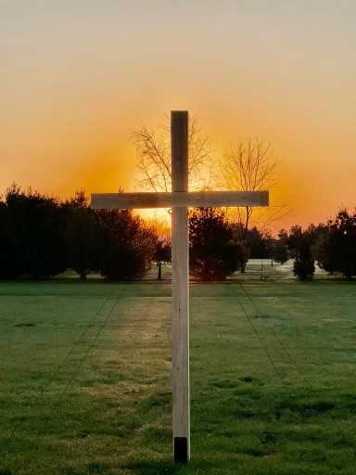
Easter Sunrise Service
March 31,2024
@ 7:30 am
Breakfast will be
served afterward.

Slide 2
1 Corinthians 15:12-20 (The Message)
¹²⁻¹⁵ Now, let me ask you something profound yet troubling. If you became believers because you trusted the proclamation that Christ is alive, risen from the dead, how can you let people say that there is no such thing as a resurrection?

Slide 3
If there’s no resurrection, there’s no living Christ. And face it—if there’s no resurrection for Christ, everything we’ve told you is smoke and mirrors, and everything you’ve staked your life on is smoke and mirrors. Not only that, but we would be guilty of telling a string of barefaced lies about God, all these affidavits we passed on to you verifying that God raised up Christ—sheer fabrications, if there’s no resurrection

Slide 4
¹⁶⁻²⁰ If corpses can’t be raised, then Christ wasn’t, because he was indeed dead. And if Christ wasn’t raised, then all you’re doing is wandering about in the dark, as lost as ever. It’s even worse for those who died hoping in Christ and resurrection, because they’re already in their graves. If all we get out of Christ is a little inspiration for a few short years, we’re a pretty sorry lot. But the truth is that Christ has been raised up, the first in a long legacy of those who are going to leave the cemeteries.

Slide 6
Easter: I Can Face Tomorrow!
2024: Living a Life of Grace
Today’s Scripture:
| John 3:1-21 |
~ Amplified Bible ~

Slide 7
The New Birth
3 Now there was a certain man among the Pharisees named Nicodemus, a ruler (member of the Sanhedrin) among the Jews, ² who came to Jesus at night and said to Him, “Rabbi (Teacher), we know [without any doubt] that You have come from God as a teacher; for no one can do these signs [these wonders, these attesting miracles] that You do unless God is with him.”

Slide 8
³ Jesus answered him, “I assure you and most solemnly say to you, unless a person is born again [reborn from above—spiritually transformed, renewed, sanctified], he cannot [ever] see and experience the kingdom of God.”

Slide 9
⁴ Nicodemus said to Him, “How can a man be born when he is old? He cannot enter his mother’s womb a second time and be born, can he?” ⁵ Jesus answered, “I assure you and most solemnly say to you, unless one is born of water and the Spirit he cannot [ever] enter the kingdom of God.

Slide 10
⁶ That which is born of the flesh is flesh [the physical is merely physical], and that which is born of the Spirit is spirit. ⁷ Do not be surprised that I have told you, ‘You must be born again [reborn from above—spiritually transformed, renewed, sanctified].’ ⁸ The wind blows where it wishes and you hear its sound, but you do not know where it is coming from and where it is going; so it is with everyone who is born of the Spirit.”

Slide 11
⁹ Nicodemus said to Him, “How can these things be
possible?” ¹⁰ Jesus replied, “You are the [great and well-known] teacher of Israel, and yet you do not know
nor understand these things [from Scripture]? ¹¹ I assure you and most solemnly say to you, we speak only of what we[absolutely] know and testify about what we have [actually] seen [as eyewitnesses]; and [still] you
[reject our evidence and] do not accept our testimony.

Slide 12
¹² If I told you earthly things [that is, things that happen right here on earth] and you do not believe, how will you believe and trust Me if I tell you heavenly things?
¹³ No one has gone up into heaven, but there is One who came down from heaven, the Son of Man
[Himself—whose home is in heaven]. ¹⁴ Just as Moses lifted up the [bronze] serpent in the desert [on a pole],
so must the Son of Man be lifted up[on the cross], ¹⁵ so that whoever believes will in Him have eternal life[after physical death, and will actually live forever].

Slide 13
¹⁶ “For God so [greatly] loved and dearly prized the world, that He[even] gave His [One and] only begotten Son, so that whoever believes and trusts in Him [as Savior] shall not perish, but have eternal life.

Slide 14
¹⁷ For God did not send the Son into the world to judge and condemn the world [that is, to initiate the final judgment of the world], but that the world might be saved through Him. ¹⁸ Whoever believes and has decided to trust in Him [as personal Savior and Lord] is not judged[for this one, there is no judgment, no rejection, no condemnation];

Slide 15
but the one who does not believe [and has decided to reject Him as personal Savior and Lord] is judged already [that one has been convicted and sentenced],
because he has not believed and trusted in the name of the [One and] only begotten Son of God [the One who is truly unique, the only One of His kind, the One who alone can save him].

Slide 16
²¹ But whoever practices truth[and does what is right—morally, ethically, spiritually] comes to the Light, so that his works may be plainly shown to be what they are—accomplished in God [divinely prompted, done with God’s help, in dependence on Him].”

