Slide 1
Let God Own Your Battle
2024: Living a Life of Grace
Today’s Scripture:
| 1 Samuel 17 |
~ Amplified Bible ~

Slide 2
2 Chronicles 20:15 - Amplified Bible (AMP)
¹⁵ He said, “Listen carefully, all [you people of] Judah, and you inhabitants of Jerusalem, and King Jehoshaphat. The Lord says this to you: ‘Be not afraid or dismayed at this great multitude, for the battle is not yours, but God’s.

Slide 3
Goliath’s Challenge
17 Now the Philistines gathered their armies for battle and were assembled at Socoh, which belongs to Judah; and they camped between Socoh and Azekah, in Ephes-dammim. ² Saul and the men of Israel were gathered together and they camped in the Valley of Elah, and assembled in battle formation to meet the Philistines.

Slide 5
³ The Philistines were standing on the mountain on one side and Israel was standing on the mountain on the other side, with the valley between them. ⁴ Then a
champion came out from the camp of the Philistines named Goliath of Gath, whose height was six cubits and a span. ( 9 feet 9 inches)

Slide 6
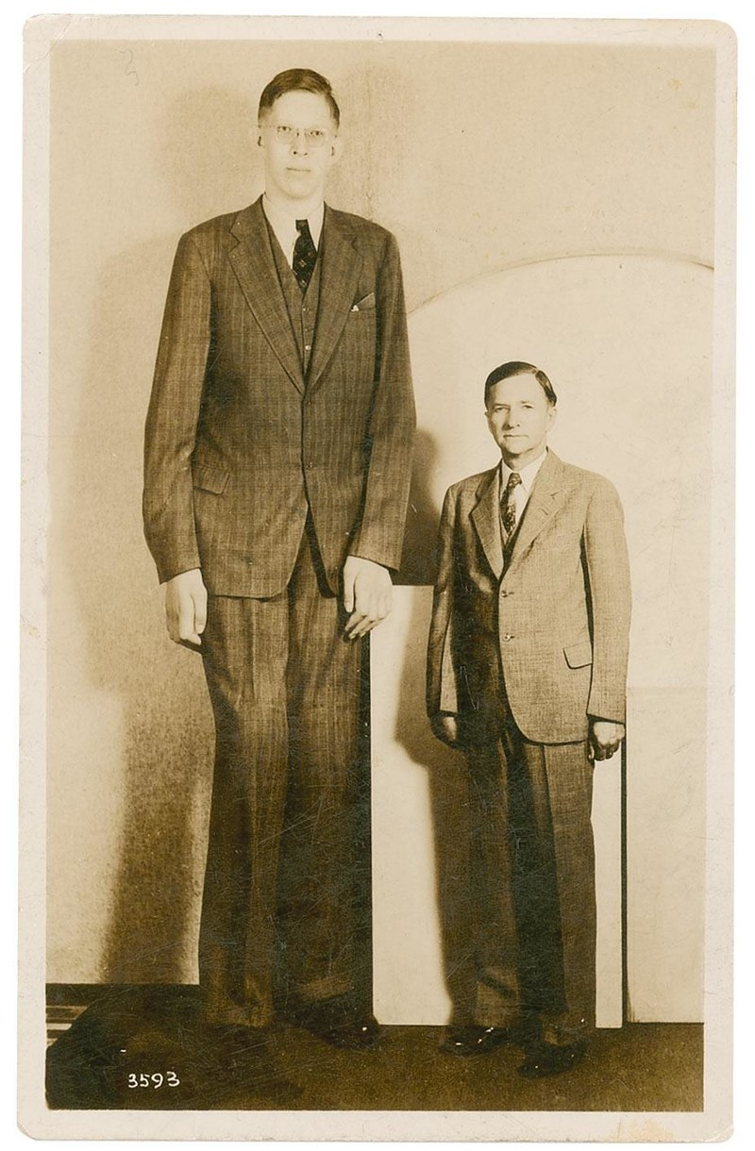

Slide 7
⁵ He had a bronze helmet on his head, and wore a
coat of scale-armor (overlapping metal plates) which weighed 5,000 shekels of bronze. ⁶ He had bronze
shin protectors on his legs and a bronze javelin hung between his shoulders. ⁷ The [wooden] shaft of his spear was like a weaver’s beam; the blade-head of his spear
weighed six hundred shekels of iron. And a shield-bearer walked in front of him.(5K shekels 126 #; 600 shekels 15#)

Slide 8
⁸ Goliath stood and shouted to the battle lines of Israel, saying to them, “Why have you come out to draw up for battle? Am I not the Philistine and are you not servants of Saul? Choose a man for yourselves and have him come down to me.

Slide 9
⁹ If he is able to fight with me and kill me, then we will become your servants; but if I prevail against him and kill him, then you shall become our servants and serve us.” ¹⁰ Again the Philistine said, “I defy the battle lines of Israel this day; give me a man so that we may fight together.” ¹¹ When Saul and all Israel heard these words of the Philistine, they were dismayed and greatly afraid.

Slide 10
1 Samuel 15
¹⁶ Then Samuel said to Saul, “Stop, and let me tell you what the Lord said to me last night.” Saul said to him, “Speak.”

Slide 11
¹⁷ Samuel said, “Is it not true that even though you were small (insignificant) in your own eyes, you were made
the head of the tribes of Israel? And the Lord anointed you king over Israel, ¹⁸ and the Lord sent you on a mission…

Slide 12
²² Samuel said,
“Has the Lord as great a delight in burnt offerings and sacrifices as in obedience to the voice of the Lord? Behold, to obey is better than sacrifice, And to heed [is better] than the fat of rams.

Slide 13
³⁴ But David said to Saul, “Your servant was tending his father’s sheep. When a lion or a bear came and took a lamb out of the flock, ³⁵ I went out after it and attacked it and rescued the lamb from its mouth; and when it rose up against me, I seized it by its whiskers and struck and killed it.

Slide 14
³⁶ Your servant has killed both the lion and the bear; and this ungodly Philistine will be like one of them, since he has taunted and defied the armies of the living God.” ³⁷ David said, “The Lord who rescued me from the paw of the lion and from the paw of the bear, He will rescue me from the hand of this Philistine.”

Slide 15
⁴⁰ Then he took his [shepherd’s] staff in his hand and chose for himself five smooth stones out of the stream bed, and put them in his shepherd’s bag which he had, that is, in his shepherd’s pouch. With his sling in his hand, he approached the Philistine.

Slide 16
⁴¹ The Philistine came and approached David, with his shield-bearer in front of him. ⁴² When the Philistine looked around and saw David, he derided and
disparaged him because he was [just] a young man, with a ruddy complexion, and a handsome appearance. ⁴³ The Philistine said to David, “Am I a dog, that you come to me with [shepherd’s] staffs?” And the Philistine cursed David by his gods.

Slide 17
⁴⁴ The Philistine also said to David, “Come to me, and I will give your flesh to the birds of the sky and the beasts of the field.” ⁴⁵ Then David said to the Philistine, “You come to me with a sword, a spear, and a javelin, but I come to you in the name of the Lord of hosts, the God of the armies of Israel, whom you have taunted.

Slide 18
⁴⁸ When the Philistine rose and came forward to meet David, David ran quickly toward the battle line to meet the Philistine. ⁴⁹ David put his hand into his bag and took out a stone and slung it, and it struck the Philistine on his forehead. The stone penetrated his forehead, and he fell face down on the ground.

Slide 19
1 Corinthians 10:4
⁴ The weapons of our warfare are not physical [weapons of flesh and blood]. Our weapons are divinely powerful for the destruction of fortresses.

